Slide 1
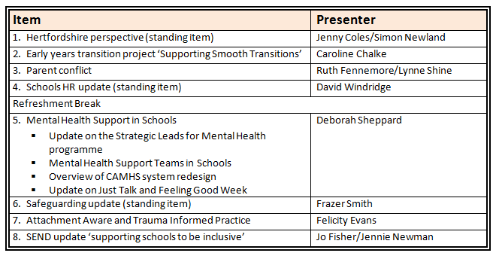
The Hertfordshire Headteacher Updates November 2019

Slide 2
The Hertfordshire Headteacher Updates
November 2019
Hertfordshire Perspective
Jenny Coles – Director of Children’s Services
Simon Newland – Operations Director, Education
Tania Rawle – Head of Standards and Accountability

Slide 3
Schools budget update
Increase in funding available per pupil of 3.6% across Hertfordshire
Estimate of inflation on pay, prices of 2.8%
Early Years per pupil funding up by 1.5%

Slide 4
Distribution of funding
Introduction of Minimum Per Pupil Funding Level of £3,750 for Primary and £5,000 per secondary
Benefits large schools, especially those in non-deprived areas
57 Primaries will receive £3.8m.
9 Secondaries/Middle will receive £0.3m.
Primary level will rise to £4,000 next year

Slide 5
Distribution of funding
Schools Forum will decide this week on an option for consultation on distributing the remainder of the funding
Our proposal is +3.6% on all unit funding rates except secondary lump sum (at max) and premises.
Information being put out by DfE and by NEU on school-level funding changes is flawed in various respects and does not reflect position of individual schools in Hertfordshire. You will not be able to reconcile it back to your budgets.

Slide 6
General Election
We will issue further guidance on assumptions for future years budget planning in new year.
Election uncertainties include:
  Total level of schools funding
  Future of the minimum per pupil level, esp Primary £4,000 and other distribution issues
  Future pay inflation
  Suggest schools refresh their asset management pans and consider R&M priorities

Slide 7
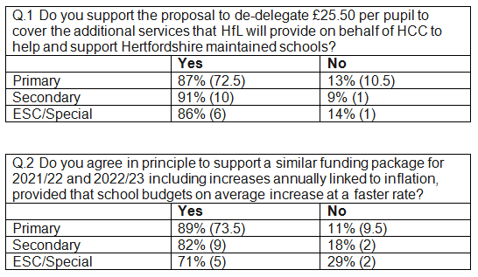
De-delegation consultation results

Slide 8
Term dates consultation for 2021/22 and 2022/23
Term Dates consultation to open on Monday 25 November 2019 and closes on 20 December 2019
Link to consultation: https://surveys.hertfordshire.gov.uk/s/termdate/
Responses to be considered by the Term Date Working Group (TDWG) on 15 January 2020
Dates to be published on 31 January 2020

Slide 9
Administration of Admission Appeals
Requirement to treat Academies and Maintained schools equally in terms of funding/charging
Need to move away from central subsidy towards traded service
Planned increase in charges/introduction of charges of £200 per appeal lodged from April
Working group including schools established to consider future service offer

Slide 10
Schools Payroll
Work underway on performance specification, with schools input
Spring 2020 – communications and engagement with schools on what the service will be
Summer 2020 – seeking commitment for schools to future service
Autumn 2020 – service designed to meet needs to those wishing to purchase it
Spring 2021 – cut over from current service

Slide 11
GroupCall Automatic Data Collection
Purpose of the project is increase the efficiency of data transfer between schools and the local authority, reduce the number of manual submissions made by schools and improve the quality of data held by the local authority.
Working Party set up to implementing automatic data collection
The Working Party arranged a “pilot” exercise with six schools to prove the technology and associated processes from end-to-end. This will include an Information Sharing Agreement, a process for schools to “sign-up”, day-to-day support arrangements, etc.

Slide 12
GroupCall Automatic Data Collection (cont)
The technical infrastructure is scheduled to be delivered and the software installed in December.
We will then operate the pilot exercise for a limited period in the New Year.
The intention is then to report back to IT PWG on the pilot and with an outline proposal on extending the automated collection to all schools.

Slide 13
Other issues
HCC/HfL have written to to schools last week with guidance on exclusions and use of AP, including “off-rolling”.
Queries coming through on issues relating to “free trial” periods – look at the small print!
The “Climate Emergency” and environmental sustainability – will be looking to develop a programme of work in relation to schools next year

Slide 14

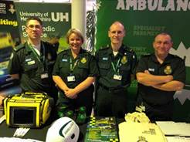
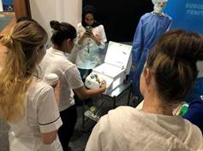


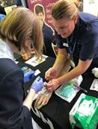
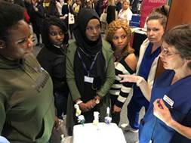
Occupational Therapy
Nurses
National Career Service
Social Work
Volunteering and Work Experience
Rehabilitation Officers
Skills for Care

Slide 15
WHEN?
Tuesday 24th March 2020
10am – 3pm
WHERE?
Fielder Centre,
Hatfield Avenue,
Hatfield, AL10 9TP
WHY?
Free to attend!
Hear first hand from people doing the job
Students can try their hand at different career disciplines
Sign up to work experience
Hear about different educational routes into the professions
Get tips on how to make successful applications

Slide 16
Questions

Slide 17

The Hertfordshire Headteacher Updates
November 2019
Supporting Smooth Transitions
The Transition Project
Caroline Chalke
Senior Early Years Adviser
eytransition@hertsforlearning.co.uk

Slide 18

Why is transition important?
‘The transition between phases of education – notably early years to primary, and primary to secondary – is a risk-point for vulnerable learners. Schools need to diagnose pupils’ needs as soon as possible in order to put in place effective support to help those falling behind to catch up.’ – pg16 The Attainment Gap report 2018 Education Endowment Foundation
‘We know that nearly half of the children from disadvantaged backgrounds have not secured the essential knowledge, skills and understanding expected for their age by the time they finish Reception Year. Around a quarter are unable to communicate effectively, control their own feelings and impulses or make sense of the world around them to ensure that they are ready to learn.’ pg3 Unknown children, Destined for Disadvantage Ofsted 2016

Slide 19

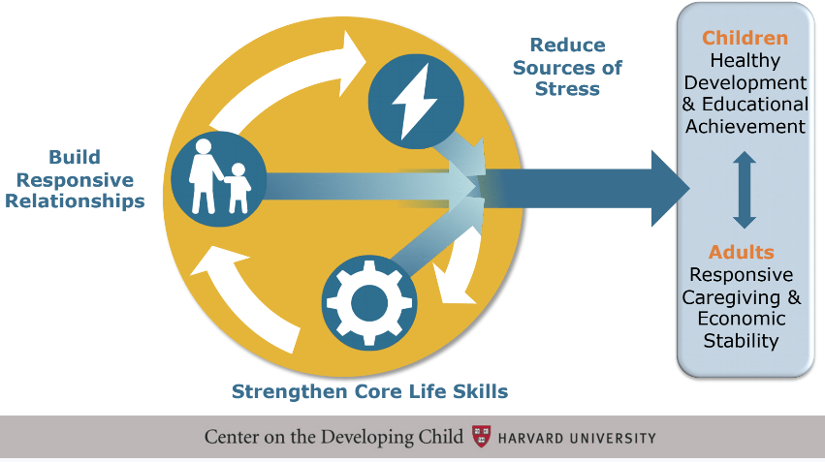
Key Scientific Concepts
Underpinning effective transition
1. Responsive relationships & positive experiences build sturdy brain architecture
2. Toxic stress disrupts the development of brain architecture & other systems
3. Core capabilities for school, work and life are built over time

Slide 20


Slide 22
Questions

Slide 23

The Hertfordshire Headteacher Updates
November 2019
Supporting Parents in Conflict
Ruth Fennemore / Lynne Shine, Family Services Commissioning

Slide 24

Why are parental relationships important?
How parents communicate and relate to each other, is increasingly recognised as a primary influence on children’s long-term mental health and future life chances
Not all conflict is damaging, but where this is frequent, intense and poorly resolved it can harm children's outcomes
There is a growing group of proven interventions to reduce parental conflict, improve child outcomes and avoid the need for expensive services in the future

Slide 25


Slide 26


Supporting parents informally
A webpage and toolkit for practitioners
A relationships support webpage for parents
www.hertfordshire.gov.uk/parentrelationships
www.hertfordshire.gov.uk/betterrelationships

Slide 27

Referring parents for more support
The Parenting Together Programme offers four new evidence based interventions to parents in conflict in Hertfordshire
The programme is delivered flexibly, around the needs of parents.
www.parentingtogethersupportprogramme.org.uk/

Slide 28
Questions

Slide 29
The Hertfordshire Headteacher
November 2019
HR update
Dave Windridge
HFL Head of HR & Recruitment Services

Slide 30
Notes:
Faces behind the email & phone lines…
Couple of new additions
Clair (commercial sector experience, multi-site engineering/facilities mgt populations)
Helen (most recently care homes, regulated sector experience)
Sadly losing Zoe & John at Xmas, with Ali also going onto maternity leave at Xmas.

Slide 31
Policy & Portal Update
  New on the HR portal this term
Guidance on co-headship
Immunisation check letter & FAQs
Guidance on school group sizes and the setting of a leadership pay range in mainstream schools
Guidance on the use of Special Educational Needs (SEN) Allowances
Guidance on school group sizes & setting of a leadership pay range in Special Schools
Guidance on the use of TLRs
Annual leave entitlement table
Annual Pay statement templates
Pay ranges information - 2019/20
Pay FAQs
Revisions still to come this term
Disciplinary policy
Redundancy policy
Probation Policy
Safer Recruitment Policy
Flexible Working Policy
Grievance Policy
Managing Performance Policy
Whistleblowing Policy
Social Media Policy
Supporting letters/guidance for these areas are also being reviewed.

Slide 32
Policy & Portal Update - continued
Coming soon… Spring 2020
Family Leave Policies
Bullying & Harassment Policy
Code of Conduct
Health & Attendance Policy
Time Off Work guidance
Alcohol, Drugs & Gambling at Work
NQT Policy
Interim/Acting Headteacher Guidance

Slide 33

HFL Occupational Health
Progress since April launch encouraging
  Reductions in average case timeline & level of DNAs vs last year
  Portal received well – phone response needs improvement
  Immunisations additional screening now built in to pre-emp
Please refer to the User guide on our HR webpages – secure portal
  Employee DNAs – will need you/your assigned person to follow-up
Do invest in Pre and post calls directly with OH team
  Referral has more opportunity for you to add free text
  There for you to get more out of the process!
Feedback facility after each use – please use this to give us more insight
Discussions underway around 2020/21 renewal price for you
Helpline: 01438 310060 or OH.HfL@optimahealth.co.uk

Slide 34
HCC Future Workforce Project - update
Initial update at last terms briefings from HCC
Part of a wider transformation project, to review & develop more effectively job structures/families across LA populations and create more flexibility in employment contracts (T&Cs)
  Would include staff employed on NJC Green book terms within LA schools – Community/VC
  Teaching populations out-of-scope
  Aim to treat schools as a dedicated ‘cohort’ with a Schools governance group
  Not proposing changes before Spring 2022
HTs will receive a written update towards the end of this term from HCC summarising key vision, desired objectives & timescales
For further information on Future Workforce, HCC HR Project Team first point of contact via future.workforce@hertfordshire.gov.uk

Slide 35

Brexit reminder
No change to the way EU, EEA & Swiss citizens prove their right to work until 1 January 2021:
They continue to be able to prove right to work in the UK as now, e.g. passport or national identity card;
Home Office online service also available if they’ve been granted status under the (now fully live) EU Settlement Scheme - employers cannot require them to do so. Employers do not have to check whether their existing employees have status under the EU Settlement Scheme;
This currently remains the same if the UK leaves the EU without a deal.
No change to reciprocal agreement re teacher qualified status or sanctions if a ‘deal’ exit is concluded.
Amendments made already to Serco/HCC new starter process
Info circulated on Schools Bulletin this term – and guidance available via HR Services and HCC Safer Staffing.
https://www.gov.uk/guidance/employing-eu-eea-and-swiss-citizens-and-their-family-members-after-brexit

Slide 36
Pay agenda
Non-teaching support staff
Review of points & rates were cascaded in April from NJC national framework review
Trade Union first proposal for 2020/21 put forward – now in collective negotiations;
We will monitor re anticipate budget projection to include in your budgeting software assumptions
More info to follow in Spring term
Teaching staff
2019/20 well underway, PRP window open again in December and up until March if needed
Reminder any/all reviews effective (backdated) to 1st Sept and should reflect performance
TPS contributions now increased; Pension Grant process underway from ESFA/HCC Finance
STRB 2020/21 remit issued by Secretary of State – requesting recommendations acknowledging key factors of affordability & retention
Expect 2020/21 to maintain current 3 ranges but may ‘load’ main range more given 2022 projection of 30k starting salary & recent pledges
Resources available on HR portal to guide School leaders & GBs; reach out if you need us

Slide 37
April 2020 – ‘Day 1’ contracts
Part of the Good Work Plan in response to the 2017 Taylor Review of Modern Working Practices.
Changes to the law relating to employment contracts will require employers to provide greater detail in contracts - and to issue them earlier in the process.
Currently, employers have to include a section 1 statement covering employment details within two months of an employee’s start date.
From April, expectations that, from day one of employment, individuals will have written:
  Details of pay terms and any benefits
  Details of training requirements
  Details of paid leave and statutory leave
  Sickness Absence Terms
  Irrespective of the length of the contract and to all workers (eg FTC, zero hours)
HCC, Serco & HFL working ahead of April to ensure processes all comply within Part 1 & 2 documentation.
For non-Serco schools, please ensure you are not caught out either if you manage in-house or via a 3PL

Slide 38
Reminder of Spring courses
School Business termly briefing 21st January
Essential introduction to HR for school leaders 22nd January
Building a firm foundation in using Microsoft Excel 27th January
Strategic absence management 30th January
Communicating effectively across teams! 5th February
Health and Safety for School business/office managers 5th February
Understanding the role of the Data Protection Officer (DPO) 6th February
Single Central Record training 12th February
Staff conduct & discipline training for managers 5th March
Developing your skills in Microsoft Word 10th March
Appraisal & capability workshop 18th March
Developing your skills in Microsoft Excel 27th March

Slide 39
Questions

Slide 40
Refreshment Break

Slide 41

1. Mental Health Support Teams in schools
2. Strategic Leads for Mental Health in Schools programme
3. CAMHS System redesign
4. Feeling Good Week
5. Just Talk
Deborah Sheppard
Senior CAMHS Commissioning Manager

Slide 42
Green paper overview
Published December 2017 – three main areas of focus:
A designated mental health lead in each school
Mental Health Support Teams (MHST’s) working with schools to strengthen support for children and young people with mental health issues
A reduction in waiting times for CAMHS with the aim that everyone would start treatment within 28 days of referral

Slide 43
Bid process (18/19)
July 2018- Herts Valleys Clinical Commissioning Group (CCG) and ENH CCG met pre-selection criteria
September 2018- Partnership bid submitted on behalf of Herts CCGs, Hertfordshire County Council (HCC), Hertfordshire Partnership Foundation Trust (HPFT) and Hertfordshire Community Trust (HCT)
December 2018- Hertfordshire announced as one of 25 successful areas
Two teams awarded, hosted by HPFT
Fully funded to 2021 with further commitment in NHS Long Term Plan to roll out further

Slide 44

Bid process (19/20)
May 2019 invited to submit bid for additional teams
Focus was on vulnerable groups including those living in areas with high levels of deprivation
Required to bid on an STP footprint as opposed to Hertfordshire
Awarded two further teams: a special school team hosted by PALMS and a team to serve Harlow hosted by Mind In West Essex
Four teams supported by programme manager, clinical lead and assistant psychologist hosted by HPFT

Slide 45
The role of MHST as set out by NHSE
The new local MHST’s will address the needs of children and young people by:
Delivering evidence based interventions in or close to schools and colleges for those with mild to moderate mental health issues (500 per year)
Helping children and young people with more severe needs to access the right support.
Working with and within schools and colleges, providing a link to specialist NHS services.
Building on and increasing support already in place, rather than replacing it

Slide 46
Model for Herts
Community CAMHS Manager
Band 8a x 0.2 FTE
Team Leader and Mental Health Practitioner
Band 7 x 1 FTE
EMHP Roles
Band 4 x 4 FTE
Mental Health Practitioner
Band 6 x 1 FTE
Admin
Band 4 x 1 FTE

Slide 47
Timeline for training / full operational capacity
Trainees commenced January / October 2019
Recruitment to other posts in Teams complete or underway with anticipated start in Jan 2020
Teams to be fully operational by Dec 2019 / September 2020 when trainees finish course
Trainees on placement two then three days a week building relationships and seeing YP as per their course requirements.

Slide 48
Potential interventions and activity in schools
Assessment of mental health needs
Signposting, guided self-help and social prescribing
Consultation and training for education staff
Support to peer mentoring programmes
Individual brief interventions for children, young people and family systems
Group interventions for CYP or parent/carers for common mental health problems
Psycho-education groups for CYP or parent/carers

Slide 49

Strategic Leads for Mental Health in Schools
Critical role in supporting the development of the Education Mental Health Support Teams model, pathways and supporting mobilisation.
HCC Behaviour Strategy input.
SEND Transformation input.
CAMHS Transformation input.
Whole School Approach promotion (kitemark and accreditation).
Ensuring the voice of schools are heard in the CAMHS Transformation plans.

Slide 50
Mental Health Leads training and resources
All Hertfordshire schools are invited to nominate a Mental Health Lead and a Deputy Lead.
Mental Health Leads and Deputy Leads are asked to attend the Mental Health Lead level 2 training and attend a refresher session after 2 years.
Quality assured slides are provided in the Level 2 training to support Leads to deliver a whole school mental health awareness session.
Leads are expected to ensure all staff have completed two e-learning modules from the national quality assured: www.Minded.org.uk
Quality assured resources and Mental Health Leads Toolkit are available on registration onto www.healthyyoungmindsinherts.org

Slide 51
The Mental Health Lead role
What it is:
What it is not:
Developing the whole school approach.
Identifying pupils with difficulties.
Liaison with local services.
Co-ordination of school based interventions.
Support for staff development and monitoring of outcomes.
The government proposes to incentivise this role.
Therapist.
The only person responsible for Children's Mental Health in school.
Having to have all the answers.
Fixing all problems/issues or children/staff or families.
Separate from the Whole School Approach to mental health and wellbeing.

Slide 52
Whole School Approach – Self Review Kitemark
A self-review document with supporting guidance has been agreed and is accessible on www.healthyyoungmindsinherts.org.uk for schools to complete and apply for the Kitemark accreditation.
Accreditation for Emotional wellbeing and mental health awareness is a prerequisite for suicide prevention awareness (which isn’t mandatory).
A multi-agency panel meet on a 6 weekly basis to review schools applications and contact schools with feedback. The panel is comprised of Schools reps, School Nursing, Public Health, Educational Psychologist and Strategic Leads for MH in Schools.
The self review framework resource is fully funded linked to the 8 key areas identified by Public Health England evidenced to improve outcomes for children and young people.
Accreditation will cover a 3 year period. Updated evidence will be required for re accreditation.

Slide 53

Whole School Approaches

Slide 54
School Information form
Feedback from GPs reflect frustrations around schools requesting GP’s to initiate a CAMHS referral while families do not always share the concerns schools may have with their GP.
Schools are aware that they are able to refer CYP directly to CAMHS although some families would rather approach their GP and not the school. A School information form has been developed to support making robust referrals to CAMHS.
The surgery / parent/ school will need to ensure that the form is completed by the school and is attached to the GP CAMHS referral (unless the school is referring directly to SPA).
This will save time in the long term and result in improved outcomes in relation to the child/ YP journey into the appropriate service.
It will also help to facilitate discussions with Single Point of Access (SPA) if school interventions are recommended as previous school based interventions will be clear.

Slide 55
Recommended steps towards school staff Wellbeing*
Is there a mental health policy that addresses the needs of staff? Is it regularly reviewed? How is the policy embedded and communicated so that all staff are aware of it?
Could measures to reduce workload or to limit hours spent working outside of the school day be trialled – for example, by reviewing marking policies and email protocols? Does the senior leadership team (SLT) lead by example when it comes to limiting emailing at evenings and weekends?
Is there a comfortable, dedicated physicals space within the school where staff members can take time out if needed?
How does the ethos of the school promote openness about mental wellbeing, and encourage staff to feel comfortable sharing concerns?
Are there opportunities for staff to participate in activities with colleagues that are not linked to their work? (for example social events, exercise classes or creative groups?)
Is it feasible to introduce a staff wellbeing survey to help understand the key issues in your school, and the impact of any measures you are taking to support staff wellbeing?
*Anna Freud National Centre for Children and Families: ‘Ten Steps Towards School Staff wellbeing’

Slide 56
MHFA Mental Health Champions 1 day course Training details
DATE | LOCATION
22nd Oct 2019 | Cheshunt
12th Nov 2019 | Potters Bar
19th Nov 2019 | St Albans
26th Nov 2019 | Hemel
3rd Dec 2019 | Watford
10th Dec 2019 | Royston
21st Jan 2020 | Ware
4th Feb 2020 | St Albans
5th Feb 2020 | Hemel
11th Feb 2020 | Watford
3rd Mar 2020 | TBC
4th March 2020 | Ware
17th Mar 2020 | St Albans
24th Mar 2020 | Hemel
31st Mar 2020 | Watford

Slide 57
MHFA FIRST AIDER / MH LEAD 2 day course Training details
Date | Location
18th and 25th October | Potters Bar
6th and 13th December | Welwyn
10th and 17th January | Broxbourne
24th and 31st January | Hemel Hampstead
7th and 14th February | Letchworth
10th and 24th February | Hatfield
28th Feb and 6th March | Potters Bar
13th and 20th March | Ware
26th and 27th March | Watford

Slide 58
  Strategic Leads for Mental Health in Schools:
  East and North Herts CCG: Breda O'Neill
  Breda.O'Neill@nhs.net
  Mobile: 07827 937573
  Herts Valleys CCG: Yael Leinman
  y.leinman@nhs.net
  Mobile: 07717 427590
  Admin support: Angela Shaw SchoolMHTraining@hertfordshire.gov.uk

Slide 59
CAMHS System Redesign
The CAMHS Transformation plan includes an overarching aim to implement sustainable system wide change
The current CAMHS system offers a range of good support but this could be more effectively co-ordinated
The current system is focused at the higher end of the continuum of need
The redesigned system will have a robust point of access to provide advice and guide families to the right support

Slide 60
CAMHS System Redesign
The range of provision will be increased, focusing on early support to reduce escalation of need
Provision will be integrated and needs focused with shared outcomes and performance management, support will wrap around the family and transcend organisational boundaries
Better access to advice and self help will empower families and non mental health professionals to manage low levels of need better

Slide 61
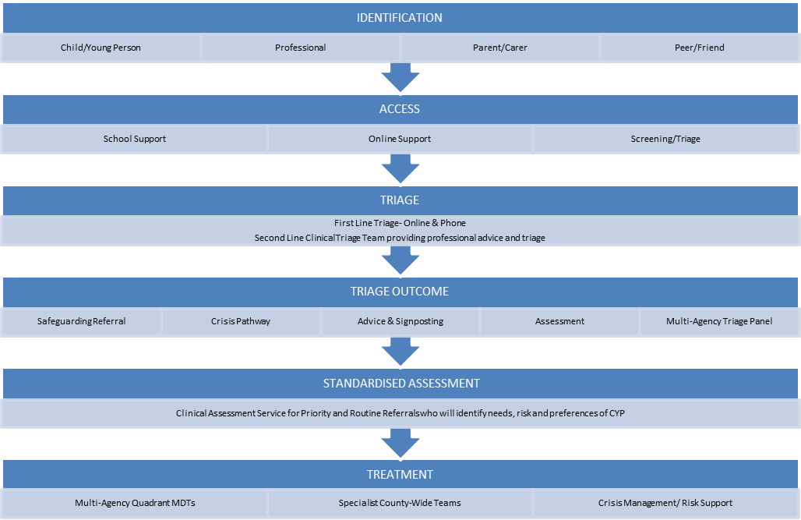

Slide 62
Governance
A Programme Manager has been recruited to map the project timelines and milestones and ensure its delivery
A group of provider and commissioner directors are overseeing the work
The Programme Group are supported by a Clinical and Operational Group with representation from Schools

Slide 63

FEELING GOOD WEEK 2020
Takes place from 10th – 16th February 2020, encouraging people to run special projects to boost CYP emotional and mental wellbeing
Up to £500 of funding available per project
The bids will be reviewed by a group of young people in December, and they will judge which projects should receive funding
Application forms can be found at https://www.healthyyoungmindsinherts.org.uk/home/feeling-good-week-february-2020
The deadline for applications is Friday 6th December 2019
This year’s theme is focused around celebrating our individuality and who we are, and knowing that even if we have labels – they do not have to define us!

Slide 64

Just Talk: A Mental Health Campaign for Hertfordshire www.justtalkherts.org
  Just Talk is a positive mental health campaign
  FREE to access: films, lesson plans, activities, leaflets, posters
  Co-produced with young people
  Easy to implement (designed by a multi-agency group including professionals from schools in Herts)
  Builds positive coping strategies, resilience, and knowledge of how to access information and support
  Campaign week:
  3rd week of November each year (next one is W/C 18th November 2019)
  Talking shows strength not weakness
  We are all affected by mental health, just like physical health
  There is support and information available and it can really help
  You’re more likely to get better if you seek help early
  Any questions: publichealth@hertfordshire.gov.uk

Slide 65

Example resource: Just Talk Resource pack https://www.justtalkherts.org/professionals/schools-colleges-and-other-professionals.aspx
Information for professionals, parents/carers, and young people:
Schools and College toolkit contains 15 minute activities, lesson plans (PE and PSHE), posters, mental health promotion ideas etc.
Parents top tips leaflet – how to speak to your child (particularly boys) about mental health
Short films – designed by young people for young people, to generate conversations about mental health (discussion guides can be found in the School and College resource pack)

Slide 66
Questions

Slide 67
The Hertfordshire Headteacher Updates
November 2019
Safeguarding Update
Frazer Smith
Team Manager – CPSLO and LADO

Slide 68

Fearless
‘Be Fearless, Speak up about violence in Hertfordshire’
‘Speak out against violence in Hertfordshire 100% anonymously’
‘Be Fearless, report any violent behaviour to Fealress.org 100% anonymously’
‘Report information about violence 100% anonymously to Fearless.org’
https://www.fearless.org/en

Slide 69
Joint Visits
Visit
You do not have to take part in Joint Assessment Visits. However, they provide a
multitude of benefits for the child, family and all professionals involved.
Let the social worker know your concerns about taking
part and come to a joint decision.
Don’t worry if you cannot attend the first assessment visit.
Plan the visit and debrief.

Slide 70
Operation Encompass
Operation Encompass is a charitable organisation set up in 2011 by David and Elizabeth Carney-Haworth OBE (a police officer and school head teacher). They recognised the necessity for police to share timely information with schools in order that children can be supported at school following Domestic Abuse Incidents they may have witnessed or been impacted by.
Currently Herts Police do provide schools notifications of Domestic Abuse incidents however, often the information has not been provided in as timely way as we would have liked, making it difficult for schools to provide that important support.
As of Monday 2nd December 2019 we will be launching Operation Encompass across Hertfordshire. This is a joint initiative between Police and Children’s Services and its aim is to provide you the information as quickly as possible and within short time parameters that we have set for ourselves.

Slide 71
Timescales
All school notifications of Domestic Abuse will be sent by the following working day. The intention is that this will also mean you may receive emails over a weekend for action on Monday morning.
All Domestic Abuse incidents which are assessed as High Risk or whereby an adult has been arrested from the family address and remains in custody will be notified by a phone call and an email to the school by 8:30am.
All Domestic Abuse incidents which are assessed as Medium Risk will be notified by email only, no later than Midday but ideally before 8:30am where possible.
All Domestic Abuse incidents which are assessed as Standard Risk will be notified by email only no later than 3pm but ideally much earlier where possible.

Slide 72


Slide 73
The Hertfordshire Headteacher Updates
November 2019
The Hertfordshire Virtual School Update
Felicity Evans
Virtual School Head

Slide 74
Developments 2019:
Previously Looked After Children – one year on
  Monthly Surgeries
  Weekly Advice Line
  The Attachment Toolkit
The Pupil Premium Plus Awards – BU2Z Awards
The Virtual School ‘Offers’
Conference, training, briefings and the website
  https://www.hertfordshire.gov.uk/microsites/virtual-school/events-and-courses/20191023-designated-teacher-training-conference.aspx

Slide 75

Virtual School Priorities 2019-20

Slide 76

Good behaviour is a necessary condition for learning: Amanda Spielman 12.09.19
Research has shown that training for all staff is a feature of effective behaviour management , this includes training for leaders and those with pastoral responsibilities.
https://edexec.co.uk/good-behaviour-is-a-necessary-condition-for-learning-new-ofsted-commentary-released/

Slide 77
Children in Need Review 2019
The children in need review, published in June 2019, found that children in this grouping were much less likely to achieve highly, even after their status as a ‘child in need’ had ended: full report.
Some headline findings:
  Young people wanted adults to be sensitive, but ambitious
  Schools to notify social workers and Virtual Head of decisions to exclude and social workers to notify school of all children in need
  Exploring extension of Virtual School model and social workers embedded in schools
  Read Professor Judy Sebba’s response to the children in need review

Slide 78
Questions

Slide 79
The Family Safeguarding Education project: The ACE Team 2019-20
Objective(s):Improve the educational progress and attainment of children on CIN or CP plans –linked to the Hertfordshire Family Safeguarding Model and the Department for Education Innovation Programme.
Scope:
Include children who have a CP plan or a CiN plan and are in year six. (children identified as the cohort will be maintained for the whole academic year regardless of the whether their plans are brought to an end)
Proposal:
Welfare Call to collect key performance data (including SATs results and attendance) from schools and also develop an electronic Plan (based on the ePEP model) to collate input from children, schools and families and monitor progress against targets. This data will be used to help inform the evaluation process at the end of the project to evidence improved outcomes for children. A team of Family Learning Practitioners.

Slide 81

The Hertfordshire Headteacher Updates
November 2019
Transforming SEND in Hertfordshire
Jo Fisher & Jennie Newman

Slide 82
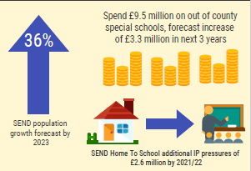
Demand and Cost Pressures
Current pressures on high needs funding and budgets driven by rising demand for services & wider demographic change
Numbers of EHC increase: from 3800 in 2015 to 7100 in 2019
Correlation between SEND and school exclusion, non attendance, low attainment, NEET
Movement of young people with SEND out of mainstream schools to more specialist and independent schools
Operational practice: getting to good

Slide 83
TRANSFORMING SEND SERVICES IN HERTFORDSHIRE
Fit for the Future - sustainable system
Workforce development - well informed practitioners
Operational excellence - right provision at the right time
Transformation –
drive collaboration and inclusion
OUTCOMES
STRATEGIC OBJECTIVES
Effective Intervention
Demand Management
Efficient Use of Resources
Behaviour & Alternative Provision
Specialist Provision / places
Targeted SEND Support
Early Years
SEND
Complex Needs Funding
SEND STRATEGY
Local integrated delivery
model of practice
Maximise the benefits
of digital technology
Better preparation for adulthood
through improved access to
independent living, employment
and training
TRANSFORMING SEND SERVICES
Whole System Governance
Communication & Engagement
Culture Change
Co-Production
Evidence-based Decision Making
ENABLERS

Slide 84
Increasing specialist provision
80+ special school places: from September 2020
Social communication hubs: 2020-21
Special free school: 2022
Additional 130+ places by 2023 especially SLD
Early years specialist provision

Slide 85
Complex Needs Funding in mainstream schools
Pupils with SEND have their needs assessed and resources allocated to mainstream school to meet those needs
Create a process for funding EHCPs via a banded system (April 2020) so that provision directly related to EHCP
Redevelop ENF process to meet emerging needs of CYP and those who do not have EHCP
  Agreement on increase of budget for CNMS (schools forum in Nov & Jan)
  Model draft descriptors of need and banding model based on graduated response (views from schools in January)
  1400 existing EHCPs assessed via new system (by March)
  Training and workbooks (Feb-March)
  All current EHCPs and ENF (non-EHCP) move to new system at review date (April onwards)

Slide 86
Operational practice: better coordination and local delivery
ISL and Specialist Advisory Teacher Service redesign
LSP and DSPL: early help and prevention
New digital platform for EHCPs: transparency and efficiency
New Local Offer in January 2020

Slide 87
Questions

Slide 88
The Hertfordshire Headteacher Updates
November 2019
Ofsted updates

Slide 89

Ofsted Update
School Inspection Update – November 2019
Topics include:
Details of minor amendments to the Section 8 and 5 handbooks to correct teething issues
Feedback on inspections so far
Clarification of approach to S8 inspections in small primary schools

Slide 90

Ofsted Update
School Inspection Update – September 2018
This update includes guidance on;
Transition arrangements for Section 5 under EIF
Applying transition arrangements for Section 8 inspections of good schools
New OFSTED parent view
Inspections of outstanding schools
Inspection of RI schools subject to a directive Academy Order

Slide 91


Section 5 and 8 handbooks
Ofsted Update (November 2019)

Slide 92

Ofsted Update
Ofsted Parent View toolkit for schools
  New Ofsted Parent View survey so that it links more closely to Ofsted’s new education inspection framework.
  Continues to ask parents how strongly they agree or disagree with statements about their child’s school, though the focus parents are asked has changed.
  Some statements have been updated and some removed. New questions including a question for parents of children with special educational needs and/or disabilities (SEND). This reflects the new framework and responds to requests from parents for a question in this area.

Slide 93
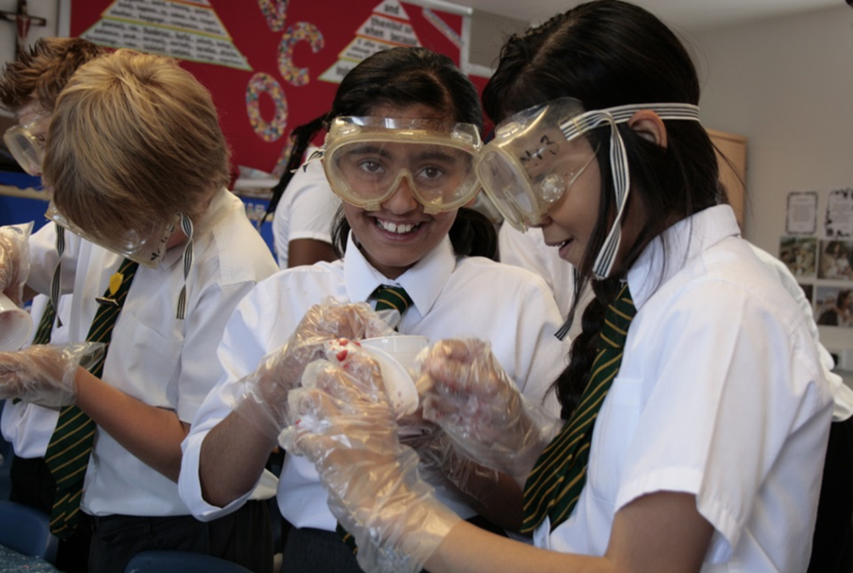
HMCI Commentary
Publication of the OFSTED report on Knife Crime
Exclusions, a correlation between exclusions and knife crime but doesn’t prove causation.
Risks of off-rolling to illegal APs

Slide 94
Questions

